Slide 1

Predictive Modeling to Detect Fake News
Evan Edmunds

Slide 2
Purpose
Fake news can be defined as false news stories used to propagate false information or rumors to change peoples’ behavior (Lorent, 2019).
Widespread and malevolent use of fake news stories could have a negative impact within society by unduly influencing citizens’ opinions in a negative way.
This project was started to determine if fake news could be detected accurately by using a predictive model.
The model would allow people to more effectively avoid possible fake news articles

Slide 3
Data
The dataset used in this project was gathered by scraping news articles from online sites.
Truthful articles were gathered from Reuters while Fake articles were gathered from sites flagged by Politifact and Wikipedia as unreliable.
The variables in the dataset:
Title
Text
Subject
Date Published
Tag (True or Fake)

Slide 4
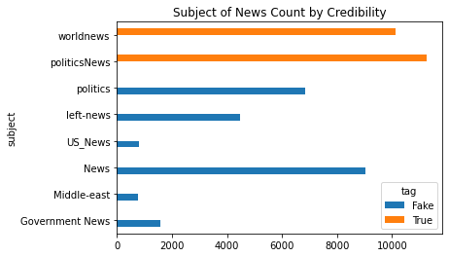
Data Exploration
There were a total of 44,898 online news articles in the dataset
21,417 (47.7%) were flagged as true
23,481 (52.3%) were flagged as fake
No overlap in subjects between
fake and true news articles
This indicates that there exists a lack of uniform coding for the subject variable which is concerning as it may negatively impact the model's ability to predict news articles not contained in the original dataset.

Slide 5
Data Cleaning
Some columns were incorrectly filled in the dataset. Such occurrences included the article website being linked in the date column and columns that did not contain any text data.
There were only 9 occurrences of these errors, and due to the low number, these observations were removed from the dataset.
Many of the True articles had the word Reuters present at the beginning of the article. The word Reuters was removed to prevent leaking data to the model.
Data was then split into testing and training datasets.

Slide 6
Preprocessing
The text data underwent various modifications to prep it for model training.
Text was converted to lowercase
All numbers, leading and trailing whitespace, and punctuation were removed from both the article and titles.
Stop words were removed
Words were then joined back together with spaces between each one.

Slide 7
Modeling
All text data was merged and then vectorized using Term Frequency – Inverse Document Frequency vectoring.
Naïve Bayes, Logistic Regression, and Random Forest Models were trained using the training data and performance was measured using cross validation.
Due to the high results of preliminary models, no hyperparameter tuning was done.
Model | Naïve Bayes | Logistic Regression | Random Forest
Accuracy (%) | 93.6 | 98.5 | 98.6

Slide 8
Results
After testing the trained models using the testing dataset, the results remained high, shown in the table.
This indicates that the models were not overfit to the training data.
Model | Naïve Bayes | Logistic Regression | Random Forest
Accuracy (%) | 94.1 | 98.8 | 99.0

Slide 9
Final Remarks
The project was success in demonstrating that a machine learning model can be used to accurately detect fake news articles.
This can be a great tool to help people disregard fake news articles intended to malevolently sway their opinion.
To further develop this model, I believe that more data should be source from a variety of sites.
Uniformly coding the subjects of the articles would help as well.

Slide 10
References and Acknowledgements
References
Ahmed H, Traore I, Saad S. “Detecting opinion spams and fake news using text classification”, Journal of Security and Privacy, Volume 1, Issue 1, Wiley, January/February 2018.
Jayaswal, V. (2020). Text Vectorization: Term Frequency — Inverse Document Frequency (TFIDF). Towards Data Science.
Lorent, S. (2019). Fake News Detection Using Machine. University of Liege.
Acknowledgements
University of Victoria in Canada

